Slide 1
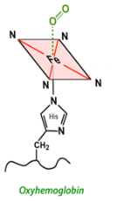
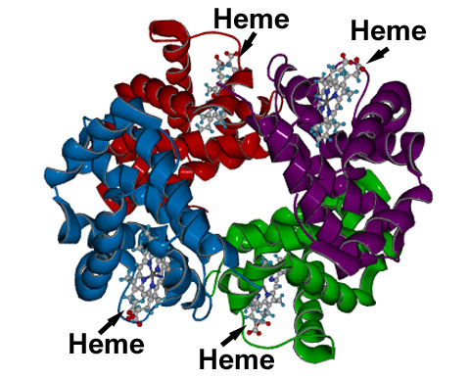
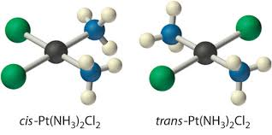
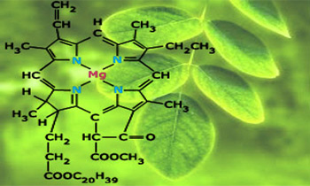
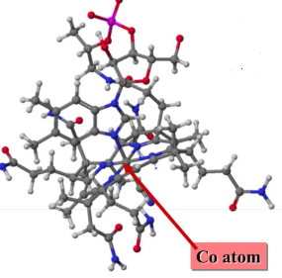
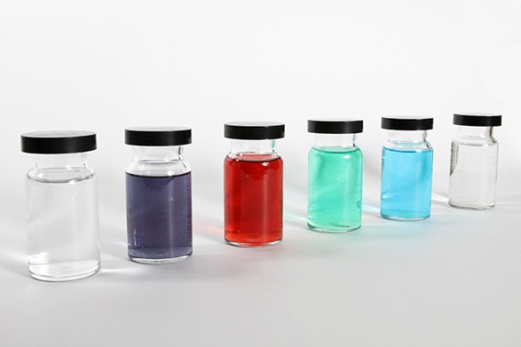
COORDINATION COMPOUNDS

Slide 9
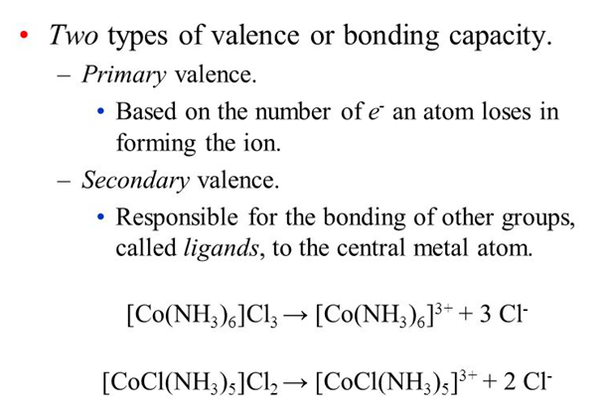

Slide 10
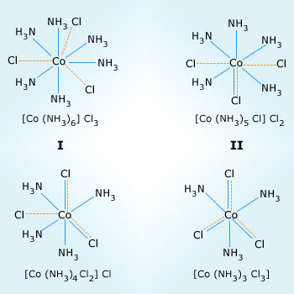

Slide 13
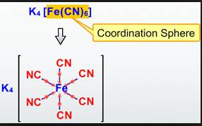
COORDINATION ENTITY:
In chemistry, a coordination complex consists of a central atom or ion, which is usually metallic and is called the coordination centre, and a surrounding array of bound molecules or ions, that are in turn known as ligands or complexing agents.
CENTRAL ATOM: An assembly consisting of a central atom (usually metallic) to which is attached a surrounding array of other groups of atoms

Slide 14
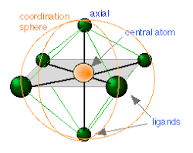

Slide 15
LIGANDS: In coordination chemistry, a ligand is an ion or molecule (functional group) that binds to a central metal atom to form a coordination complex.
DENTICITY: Denticity refers to the number of donor groups in a single ligand that bind to a central atom in a coordination complex. ... The word denticity is derived from dentis, the Latin word for tooth. The ligand is thought of as biting the metal at one or more linkage points.

Slide 16
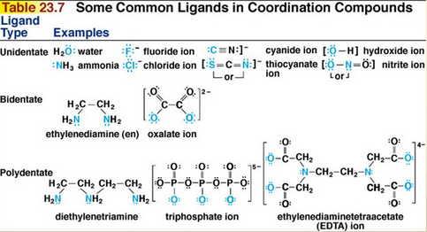

Slide 17
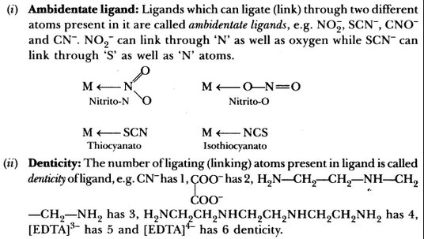

Slide 18
